Slide 1
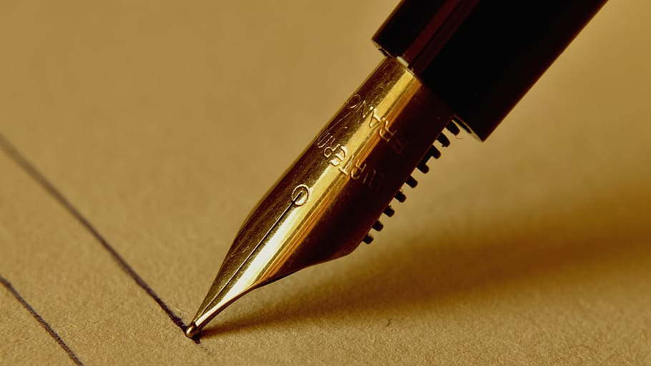
Hand written signature verification using convolutional neural networks
Project Team : 17
Hema Varshini Danda (11607391)
Dheeraj Avadhanula (11554271)

Slide 2
contents
Introduction.
Motivation.
Literature.
Model Approach.
Technical Part.
Results.
Challenges faced.
Conclusion.
References.

Slide 3
introduction
Signature verification programming has now turned out to be light weight, quick, adaptable with different alternatives for capacity, numerous marks against one ID and an enormous database.
So when a signature is to be verified, then we need to check it with the whole database. This procedure requires more time and it is less efficient.
To improve the efficiency Artificial Neural Networks through which the results can be obtained in less time. As handwritten signatures are images, so we used ConvNet ( Convolutional Neural Networks) most commonly used to classify the images.

Slide 4
MOTIVATION
The main objective of signature verification systems is to discriminate if a given signature is genuine, or a forgery.
Signature verification programming has now turned out to be lightweight, quick, adaptable with different alternatives capacity, numerous marks against one ID and an enormous database.
So, when a signature is to be verified, then we need to check it with the old database. This procedure requires more time and it is less efficient.
This has demonstrated to be a challenging task, in particular in the offline (Static) scenario that uses images of scanned signatures.

Slide 5
Literature survey
One technique is PMT (Pixel matching Technique), where the image of the signature is divided into pictures. After clearing the noise form the pixels, then the verification is done whether the signature is genuine or not.
Another technique is based on Image recognition, DWT ( Discrete Wavelet Transform) and Image Fusion.
To extract features, at first, DWT is used to access details of signature; In. the classification phase, Euclidean distance between the test image and each pattern is used in different sub-bands.

Slide 6
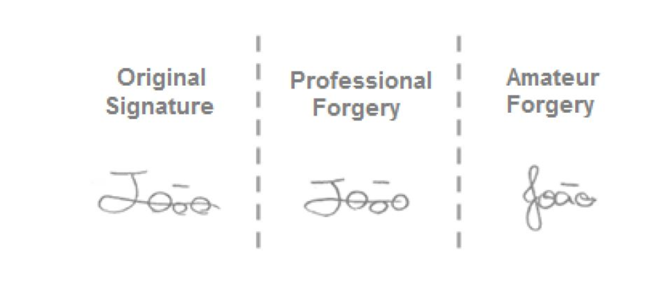
Literature survey
Example of a comparison between a original signature, a professional forgery and a forgery made by a person without knowledge of the original signature.

Slide 7
Proposed Method
In our proposed Solution, we have 3 steps to be done
Preprocessing
Network Training
Signature Verification
In Preprocessing, noise removal and segregation of images into genuine and forged ones.
The network must be trained with both forged and genuine signatures. So these images are sent through series of layers.
Coming to the verification, the test dataset is sent to the network based on the features in the network the signature could be verified.

Slide 8
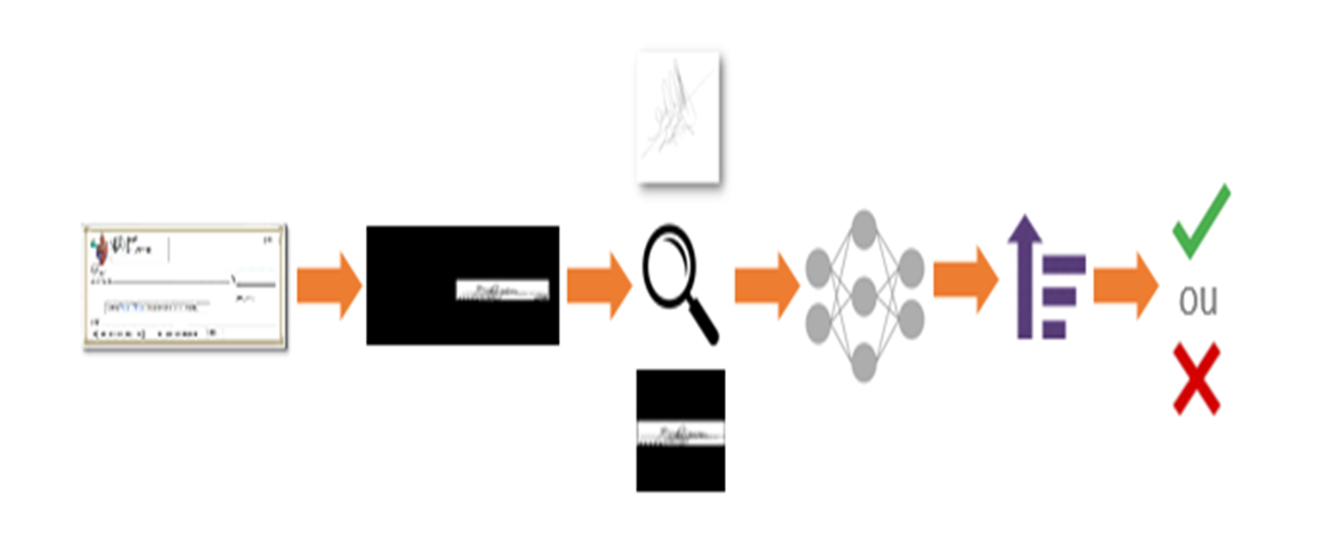
Proposed Method
Here is the work flow.

Slide 9
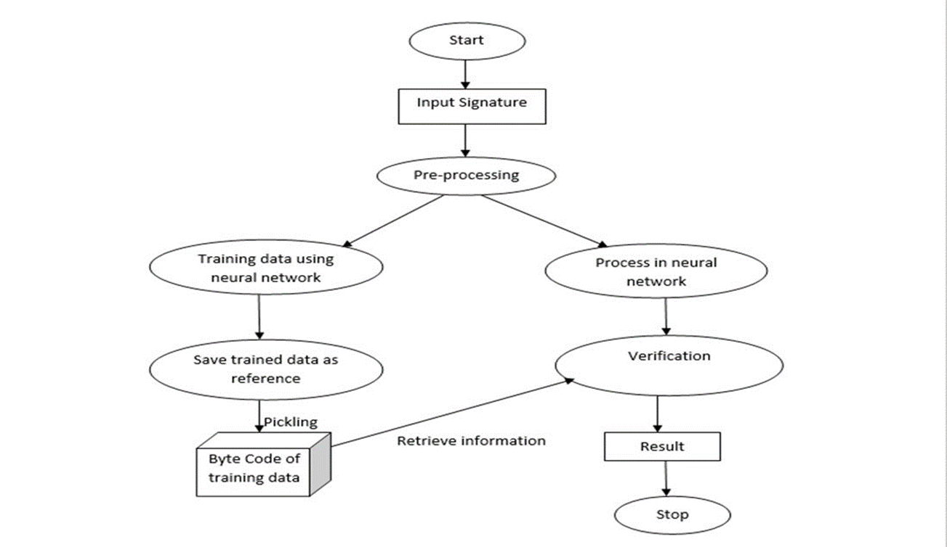
WORK PROCESS
Here is our work process.

Slide 10
pickling
The dataset contains large number of files so every time adding them to the training set would be difficult so pickle the datasets i.e., serializing the python object.
By pickling we can eliminate the back and forth movements repeatedly. By pickling we can save both time and space. We can to get the pickled data in another file by using the functions,
Before pickling is done features and labels must be identified. But in ConvNet the network itself identifies the features. So, for pickling we have selected 2 arrays one for the features(X) and other for labels(Y).

Slide 11
Vgg architecture
VGG Architecture consists of 16 layers and it has very uniform architecture. This Architecture is preferred when the goal is extracting features from images.
In both training and testing we have used VGG architecture. The layers which we are using in VGGNet are,
Convolutional Layer
Max Pool Layer
Activation Layer
Dense Layer

Slide 12
layers
Convolutional Layer – It process an input by sliding several small filters across each possible region and outputs the dot product of the filter and image at each region.
model.add(Conv2D(256, (3, 3)))
MaxPool Layer – It decrease the size of a picture by consolidating n x n area of the contribution to a single output.
model.add(MaxPooling2D(pool_size=(2, 2)))
Activation Layer – It is layer using which the initiation of the above 2 layers is done.
model.add(Activation('relu'))
Dense Layers – It is used to convert into 1D vector and for connecting to output layers respectively.
model.add(Dense(64))

Slide 13
TECH STACK
Platform Sources :​
1. Anaconda​.
2. Jupyter Notebook​.
3. Orange​.
4. Rstudio​.
5. Visual Studio​.
6. Qt Console.
Software Requirements :
1.Spyder.
2. Numpy.
3. Tensor Flow.
4. Keras.

Slide 14
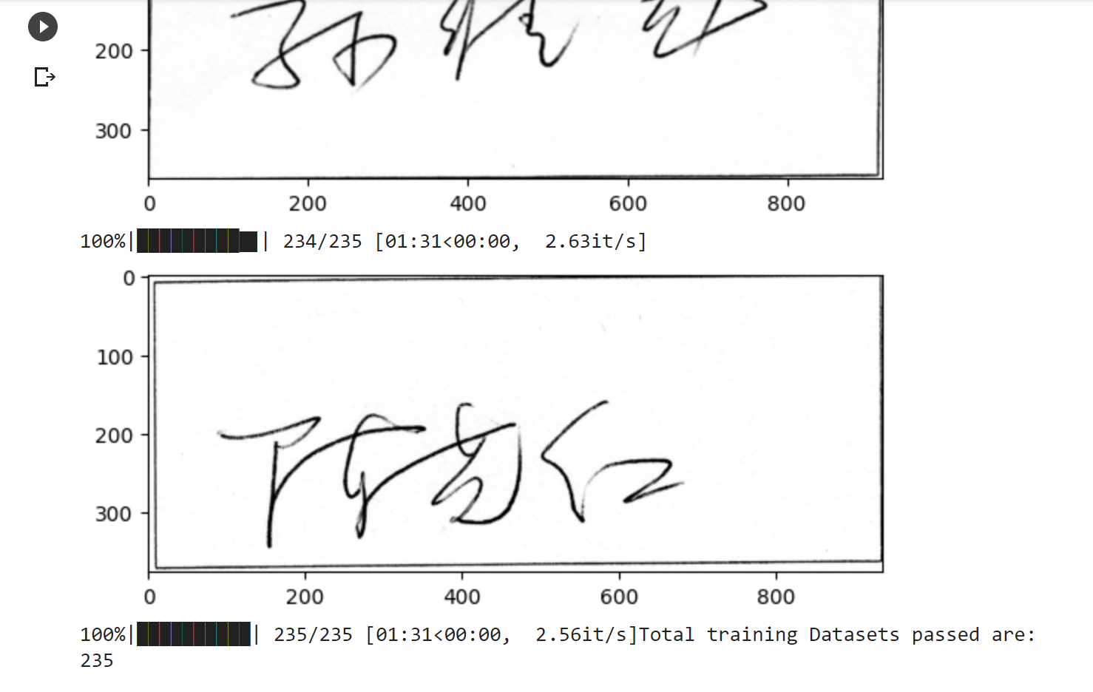
results

Slide 15
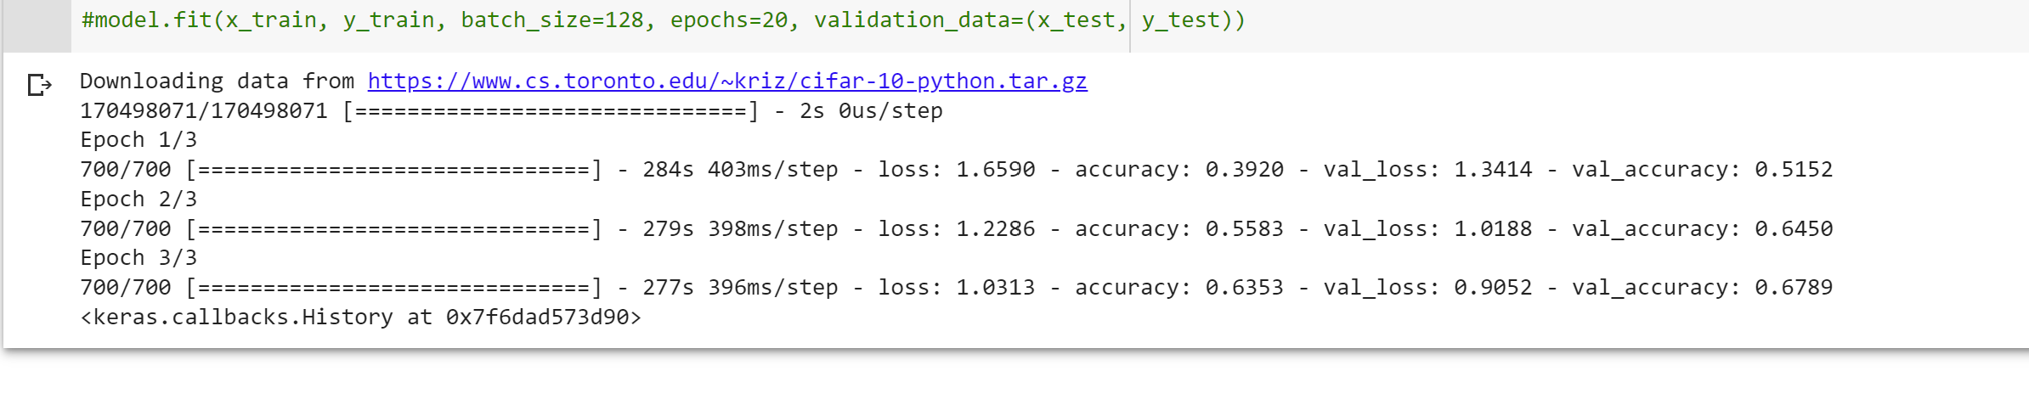
results

Slide 16
Challenges faced
Variability in signature appearance.
Small dataset size.
Forgeries.
Overfitting.
Misalignments and distortions.
Computational complexity.

Slide 17
conclusion
In signature verification using convolutional Neural Networks can decreases the time to verify whether the signature is valid or not.
Network building and feature extraction can be completed in a simple way and results in high efficiency when compared to the existing techniques.
This is beneficial to the genuine users/customers as the well trained network can help to prevent the loss that may be due to forgeries.

Slide 18
Future scope
To develop an user interface, which can make the user to use the system in a better way.
At present we are training with the limited number of signatures, for further implementation there is requirement for more datasets through which the efficiency obtained would be more.

Slide 19
Any Questions?
Thank You

